Slide 1
MS Azure – Day 2

Slide 2
Azure Infrastructure
Notes:
Day - 1
Duration -120 Mins
Mode of delivery : Instructor Lead

Slide 3
What you will learn
At the core of the lesson
You will learn:
Azure infrastructure and datacentres.
Virtual machines (VMs) and Azure VM types.

Slide 4
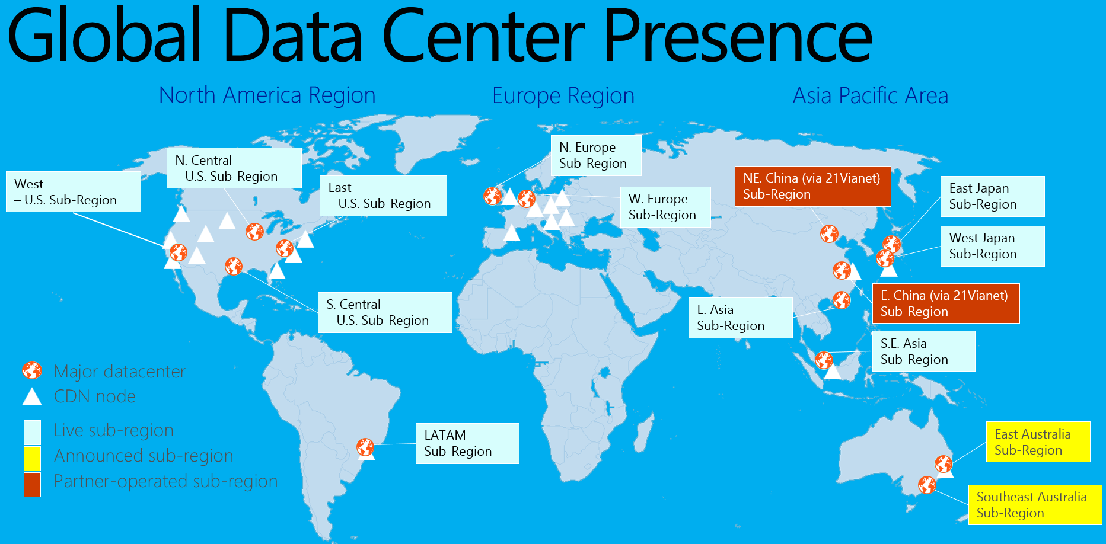
Azure Data Centers
Data Centers: Azure operates a vast network of data centers spread across different regions worldwide.
As of my knowledge cutoff in September 2021, Azure had over 60 regions globally, with multiple data centers within each region. These regions are further classified as Azure geographies, such as Americas, Europe, Asia Pacific, and so on.

Slide 5
Infrastructure Components:
Azure data centers consist of various infrastructure components that work together to deliver cloud services.
Servers and Compute
Storage
Networking
Load Balancers
Security
Power and cooling
Notes:
Chapter -2 Day -2 Infrastructure Components:

Slide 6
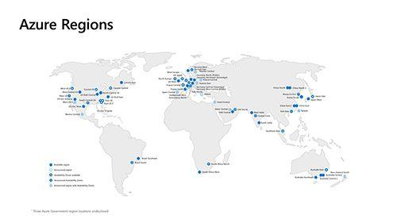
Azure Regions
Azure regions refer to geographically dispersed locations where Microsoft Azure has established data centers. Each region is a separate geographic area that contains one or more data centers.
These regions are strategically placed around the world to provide customers with localized access to Azure services, low-latency performance, and compliance with data residency requirements.
Notes:
Chapter – 2 : Azure Regions
Azure regions consist of multiple data centers located in close proximity to provide high availability and disaster recovery capabilities.
Each region is independent of other regions, and the data centers within a region are connected through a high-speed network backbone.
Each Azure region is independent and is designed to provide high availability, fault tolerance, and disaster recovery capabilities. Azure regions are further classified into Azure geographies, such as Americas, Europe, Asia Pacific, and so on, to group regions based on their geographic proximity.
Currently there are 60+ Azure Regions and 164 Aavailability zones.

Slide 7
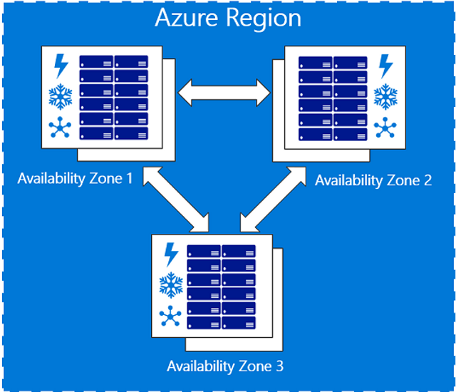
Azure Availability zone
Azure Availability Zones are physically separate data centers within an Azure region.
They are designed to provide high availability and resiliency for applications and services deployed in Azure.
Notes:
Chapter – 2 Availability Zone
Key features of Azure Availability Zones include:
Fault Isolation: Each Availability Zone is designed to be an isolated failure domain, meaning that if one Availability Zone experiences an issue, the other zones within the region should remain unaffected.
Redundancy: By deploying resources across multiple Availability Zones, customers can achieve redundancy and improve the overall availability of their applications.
High-speed Networking: Azure provides high-speed, low-latency networking between Availability Zones within a region.
SLA Coverage: Azure offers a Service Level Agreement (SLA) for virtual machines and storage that are deployed across Availability Zones.

Slide 8
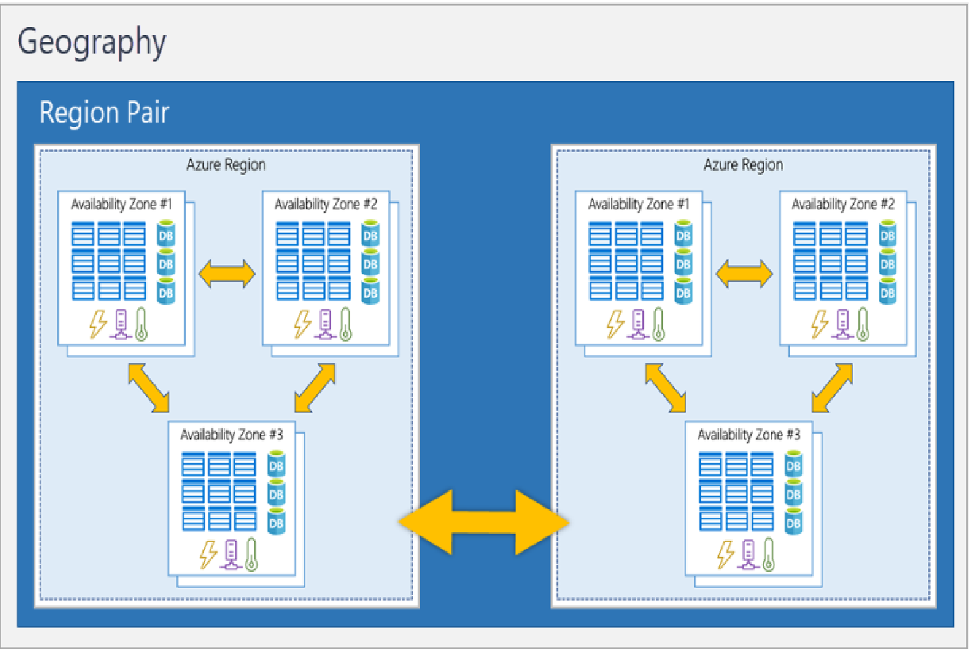
Region Pairs
Most Azure regions are paired with another region within the same geography.
Each Azure Region in a pair are always located greater than 300 miles apart when possible.
Azure Regions in a Pair have direct connections which bring additional benefits to use them together.
Notes:
Chapter – 2 Region pairs
If one of the regions were to experience a disaster or failure, then the services in that region will automatically failover to that region's secondary region in the pair.

Slide 9
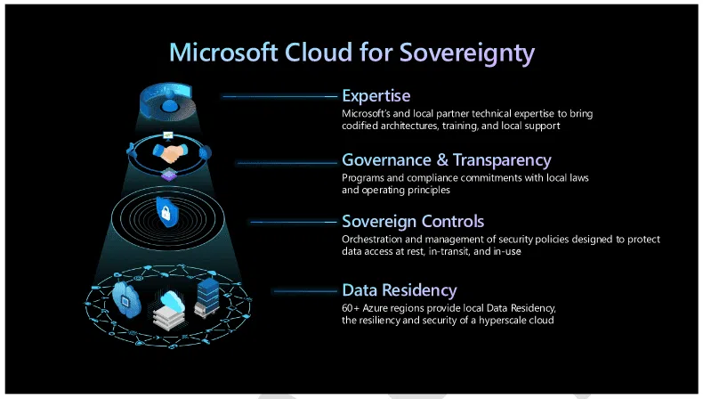
Sovereign Regions
Sovereign regions are instances of Azure that are isolated from the main instance of Azure.
You may need to use a sovereign region for compliance or legal purposes.
Notes:
Chapter – 2 Sovereign Regions
Azure sovereign regions include:
US DoD Central, US Gov Virginia, US Gov Iowa and more: These regions are physical and logical network-isolated instances of Azure for U.S. government agencies and partners. These datacenters are operated by screened U.S. personnel and include additional compliance certifications.
China East, China North, and more: These regions are available through a unique partnership between Microsoft and 21Vianet, whereby Microsoft doesn't directly maintain the datacenters.

Slide 10
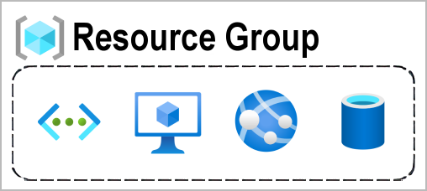
Azure Management Infrastructure
Azure resources and resource groups
Anything you create, provision, deploy, etc. is a resource(Ex: Compute, Storage, Networking etc.,)
Resource groups are simply groupings of resources.
Resource groups provide a convenient way to group resources together.
Notes:
Chapter – 2 Azure management infrastructure
You can create a resource; you’re required to place it into a resource group. While a resource group can contain many resources, a single resource can only be in one resource group at a time.
Some resources may be moved between resource groups, but when you move a resource to a new group, it will no longer be associated with the former group. Additionally, resource groups can't be nested, meaning you can’t put resource group B inside of resource group A.
When you apply an action to a resource group, that action will apply to all the resources within the resource group.
If you delete a resource group, all the resources will be deleted.
If you grant or deny access to a resource group, you’ve granted or denied access to all the resources within the resource group.

Slide 11
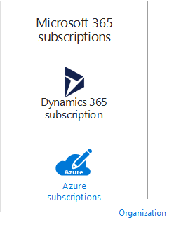
Azure Subscriptions
A subscription is an agreement with Microsoft to use one or more Microsoft cloud platforms or services.
Charges accrue based on either a per-user license fee or on cloud-based resource consumption.
Example of multiple subscriptions for an organization:
Notes:
Chapter – 2 Azure suscription
Organizations can have multiple subscriptions for Microsoft's cloud offerings. Figure shows a single organization that has multiple Microsoft 365 subscriptions, a Dynamics 365 subscription, and multiple Azure subscriptions.

Slide 12
Azure Compute Services
Azure Virtual Machine
App Service
Azure Functions
Azure Batch
Azure Container

Slide 13
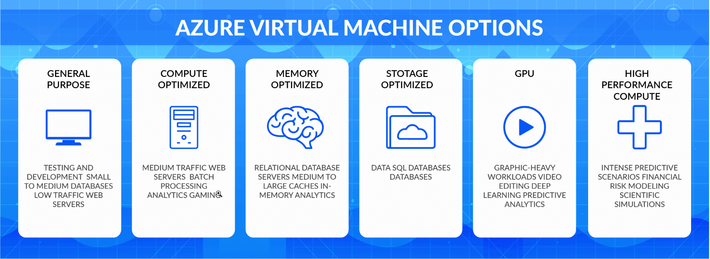
Compute Service(Virtual machines in Azure )
Azure virtual machines are one of several types of on-demand, scalable computing resources
Azure VMs allow you to run a wide range of operating systems and software on virtualized infrastructure hosted in Azure data centers.
Azure Virtual Machines provide a flexible and scalable infrastructure for running a wide range of applications in the cloud. With Azure's global presence, you can deploy VMs in multiple regions to meet your specific requirements for performance, availability, and data residency.
Notes:
Chapter – 2 Virtual Machine

Slide 14
Azure Virtual Machine Benefits
Cost savings
Agility and speed
Lowered downtime
Scalability
Security benefits
Notes:
Chapter – 2 Virtual Machine
Cost savings—running multiple virtual environments from one piece of infrastructure means that you can drastically reduce your physical infrastructure footprint. This boosts your bottom line—decreasing the need to maintain nearly as many servers and saving on maintenance costs and electricity.
Agility and speed—Spinning up a VM is relatively easy and quick and is much simpler than provisioning an entire new environment for your developers. Virtualization makes the process of running dev-test scenarios a lot quicker.
Lowered downtime—VMs are so portable and easy to move from one hypervisor to another on a different machine—this means that they are a great solution for backup, in the event the host goes down unexpectedly.
Scalability—VMs allow you to more easily scale your apps by adding more physical or virtual servers to distribute the workload across multiple VMs. As a result you can increase the availability and performance of your apps.
Security benefits— Because virtual machines run in multiple operating systems, using a guest operating system on a VM allows you to run apps of questionable security and protects your host operating system. VMs also allow for better security forensics, and are often used to safely study computer viruses, isolating the viruses to avoid risking their host computer.

Slide 15
Azure VM Sizes
It is important to select the right VM size and type for the working of our virtual machine perfectly.
VM sizes that are available within Azure:
General-purpose
Compute-optimized
Memory-optimized
Storage optimized
GPU
High performance compute
Notes:
Chapter – 2 Virtual Machine
The different VM sizes indicate the different numbers and speed CPU, different amounts of memory, a maximum number of network adapters or data disks that users can attach to it, and the maximum size of a temporary disk.
General-purpose - It has balanced CPU-to -memory ratio, It is ideal for testing and development, small to medium databases, and low to medium traffic web servers.
Compute-optimized - It has a high CPU-to-memory ratio. It is suitable for medium traffic web servers, network appliances, batch processes.
Memory-optimized - Is has a high memory-to-CPU ratio. Great for relational database servers, medium to large caches, and in-memory analytics.
Storage optimized - It has high disk throughput and IO that is Ideal for Big Data, SQL, and NoSQL databases.
GPU - It is a specialized virtual machine that is targeted for heavy graphic rendering and video editing. Available with single or multiple GPUs.
High performance compute - It is the fastest and most powerful CPU virtual machine with optional high-throughput network interfaces (RDMA).

Slide 16
VM Scaling
Generally, there are two kinds of scaling in the cloud:
Vertical scaling is also called as scale up.
Horizontal scaling is also called as scale out.
Notes:
Chapter – 2 Virtual Machine
Vertical scaling is also called as scale up. Vertical scaling increases the capacity of existing hardware or software by adding compute resources, such as CPU memory-based processing power to a server, to make it faster. In this context, it means that users can scale by changing the VM's size.
Horizontal scaling is also called as scale out. Horizontal scaling is used to increase the number of multiple entities so that they can handle more incoming requests while scaling in the case of peak time, such as Black Friday. In this context, it means that users can scale by increasing or decreasing the number of VMs that reside in the same Availability Set and share their load through internal or external load balancing. To implement horizontal scaling of Azure VMs, Azure virtual machine scale sets (scale sets) would be a great choice.

Slide 17
Creating Azure Virtual machine
Step-1: Login to https://portal.azure.com.
Step-2: Now click on the “Virtual machines” option from the left side Menu and then click on the “Create” link. Or Go to the “Virtual machines” option from the “Azure services” section.
Step- 3: Fill the details required. A few of the options you can keep as it is but based on your business need you can change those.
Now click on “Next: Disks >” button.
You can add the disk architecture that you want(or)default option as it is.
Click on Next: Networking button.

Slide 18
Now for other tabs all the options you can keep as it is. Once you fill all the above details click on the “Review + Create” button. Azure will validate the above details internally and will show a message “Validation passed”.
Step- 4: Now click on the “Create” button. It will show you “Your deployment is complete“. Now click on “Go to resource”.
Step- 5: Congratulations, Now you have created the VM successfully. Click on the Connect button to connect to the VM.

Slide 19
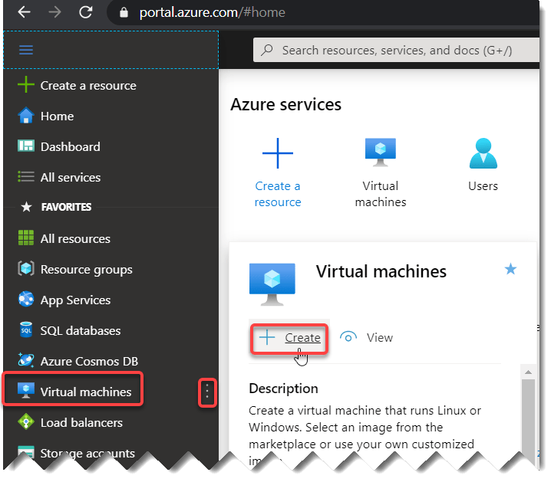
Hands-on to launch Windows Virtual Machine
Step-1: Login to https://portal.azure.com.
Step-2: Now click on the “Virtual machines” option from the left side Menu and then click on the “Create” link.

Slide 20
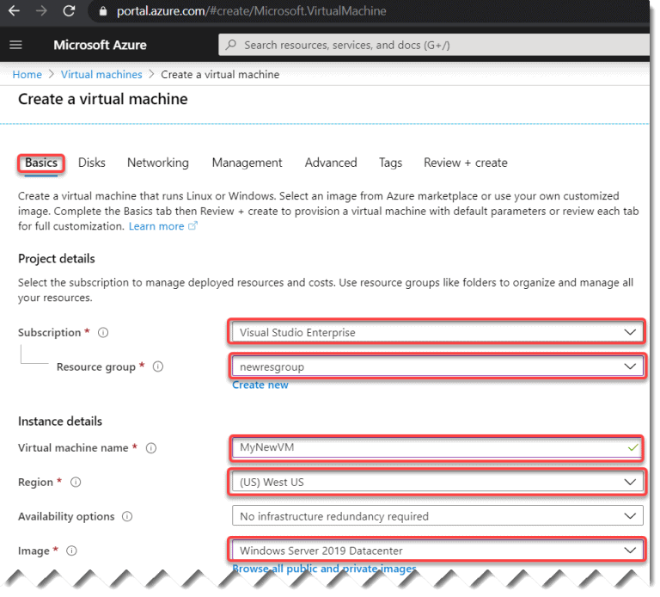
Step- 3: Fill the details required. A few of the options you can keep as it is but based on your business need you can change those.

Slide 21
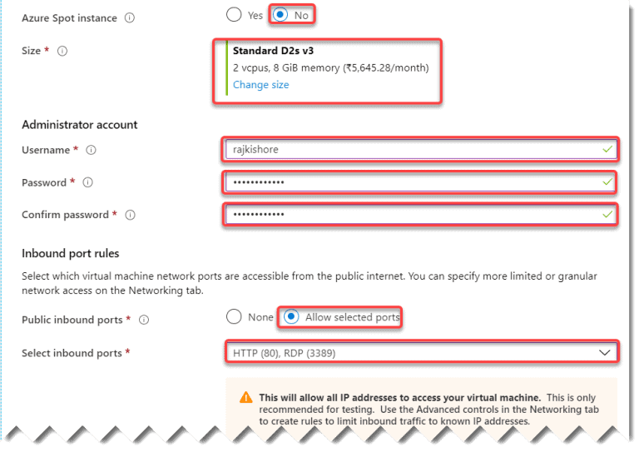

Slide 22
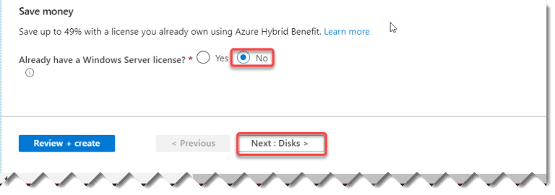

Slide 23
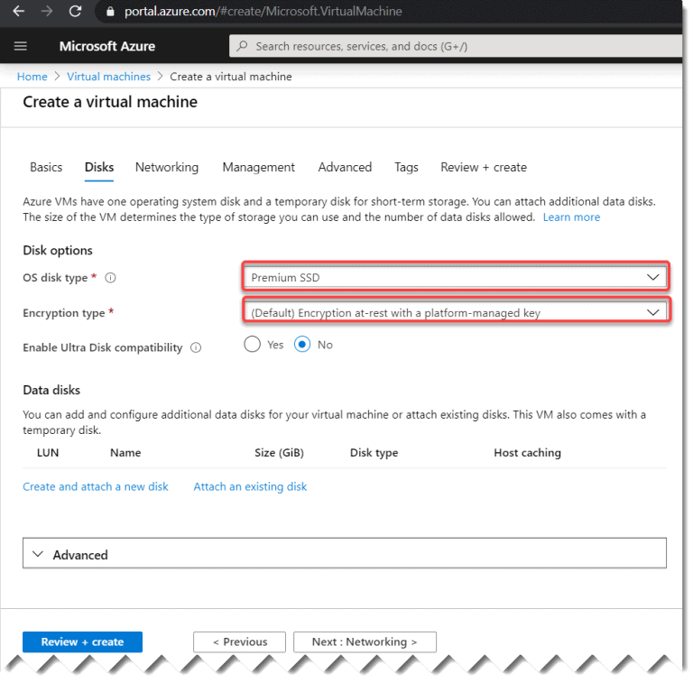
Click on “Next: Disks >” button

Slide 24
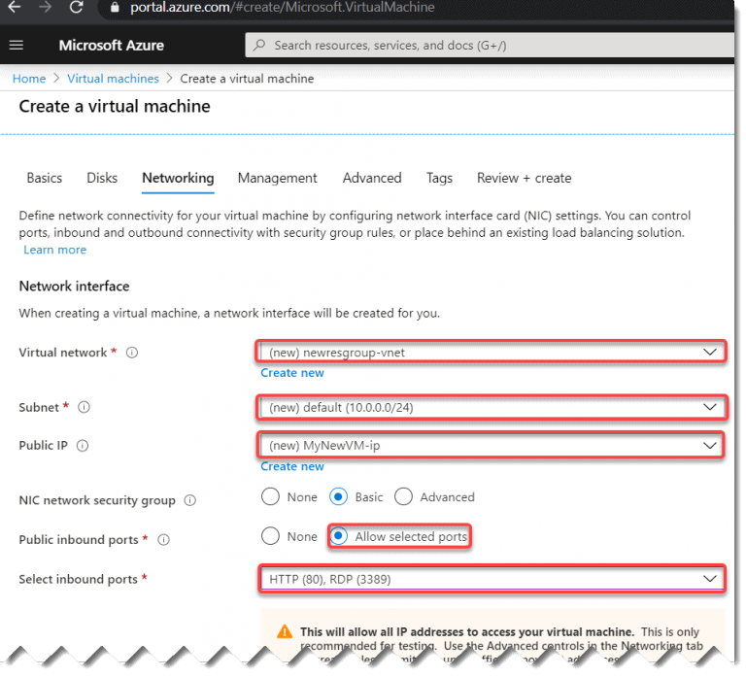
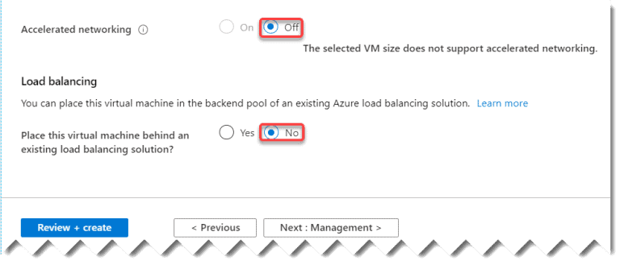
Click on Next: Networking button

Slide 25
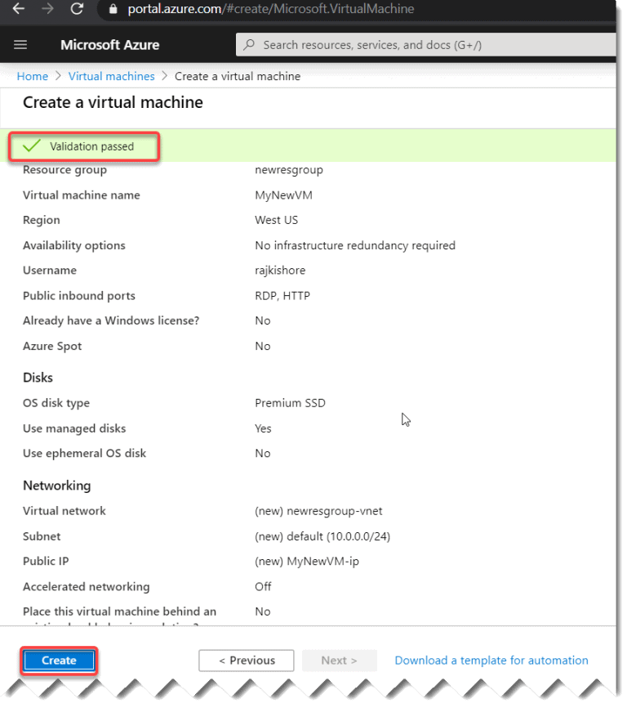
Click on the “Review + Create” button. Azure will validate the above details internally and will show a message “Validation passed”.

Slide 26
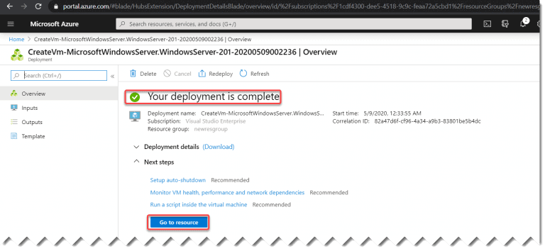
Step- 4: Now click on the “Create” button. It will show you “Your deployment is complete". Now click on “Go to resource”

Slide 27
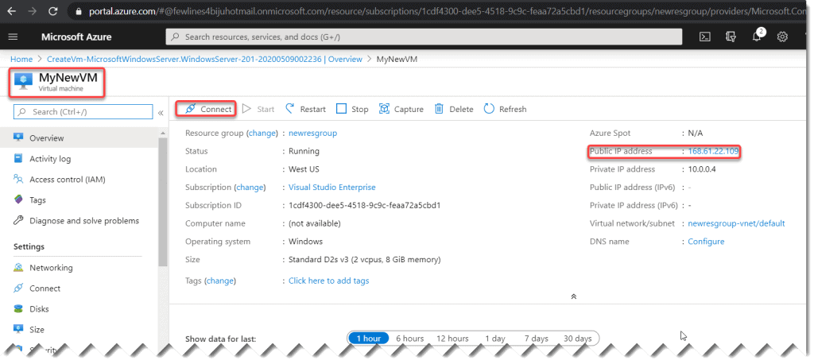
Step- 5: Congratulations, Now you have created the VM successfully. Click on the Connect button to connect to the VM.

Slide 28
THANK YOU

